Slide 1
Machine Learning
Gradient Descent Algorithm
Linear Regression
Non-Linear Regression
Logistic Regression
Decision Trees
Regression Trees
Classification Trees
Clustering Algorithms
K-Means
Hierarchical clustering
DB-Scan
Mean Shift
GMM
Support Vector Machine
Deep Learning
MLP
CNN
Datasets
Breast Cancer Wisconsin
MIMIC-III
Framingham Heart Study
Alzheimer’s Disease Neuroimaging Initiative
Drug discovery
Microbiome

Slide 2
Tree Based Models
my humble ML course

Slide 3
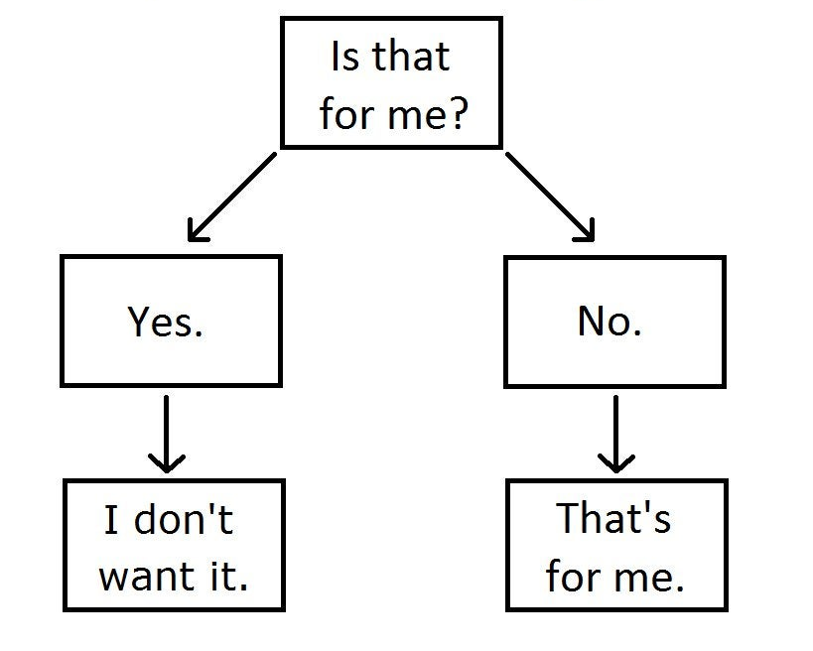
C4 – Decision Trees
my humble ML course

Slide 4
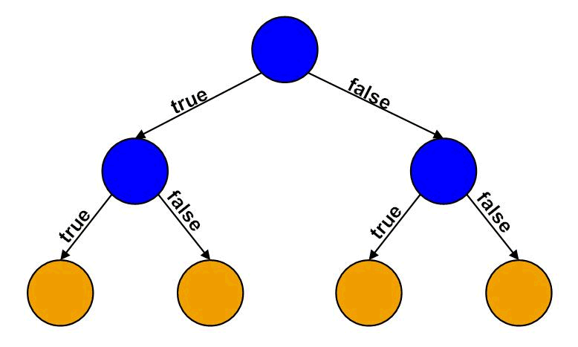
my humble ML course
Decision Tree
GOAL: Learn if else-questions with each question involving one feature and one split-point
HOW:
Divides the feature-space (N-dimensional) into regions where all instances in one region are assigned to only one class-label (discrete or continue).

Slide 5
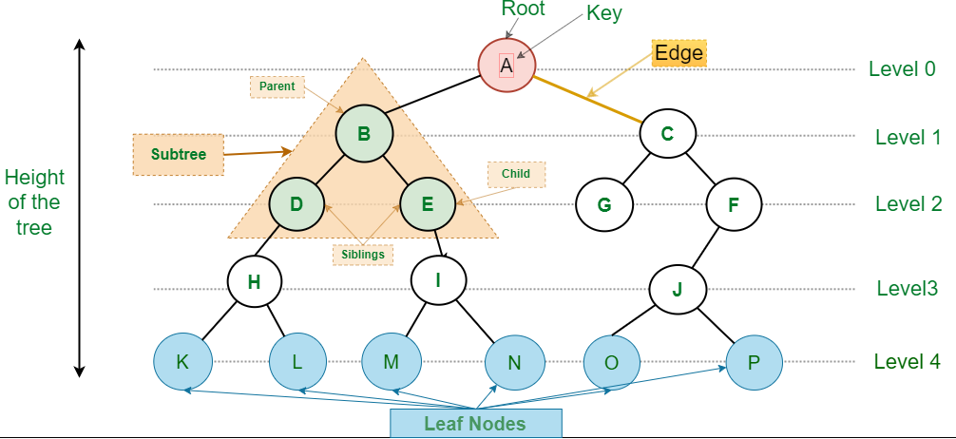
my humble ML course
Decision Tree building blocks
DT: data structure consisting of a hierarchy of nodes (individual units).
NODE:
ROOT: no-parent node
INTERNAL NODE: question giving rise to two children nodes
LEAF: prediction(discrete or continue), no children nodes.

Slide 6
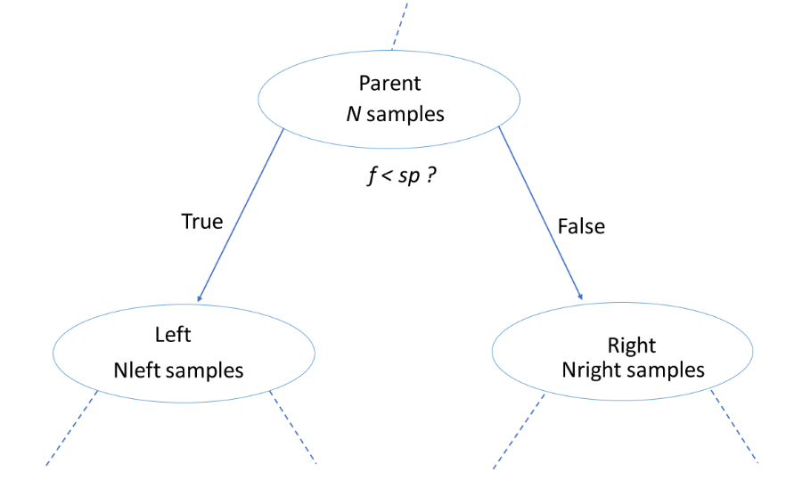
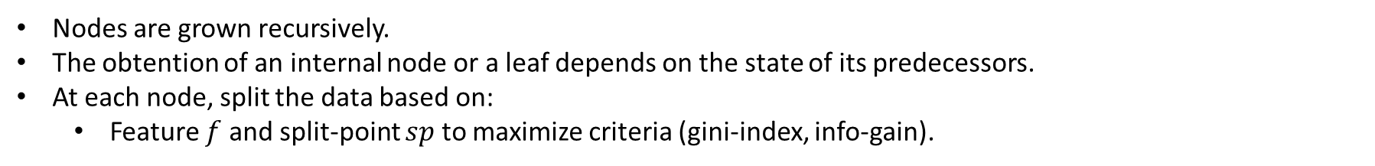
my humble ML course
Decision Tree construction/learning
Decision Tree construction/learning
Nodes are grown recursively.
The obtention of an internal node or a leaf depends on the state of its predecessors.
At each node, split the data based on:
Feature $f$ and split-point $sp$ to maximize criteria (gini-index, info-gain).

Slide 7
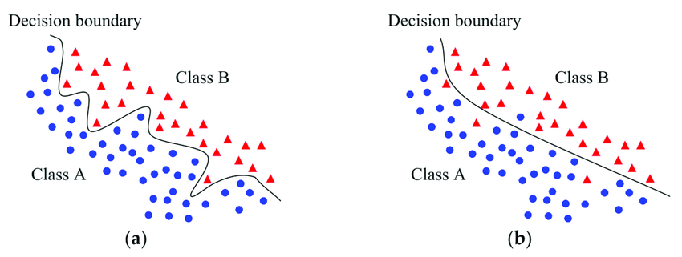
my humble ML course
Decision boundaries
Surface separating different decision regions

Slide 8
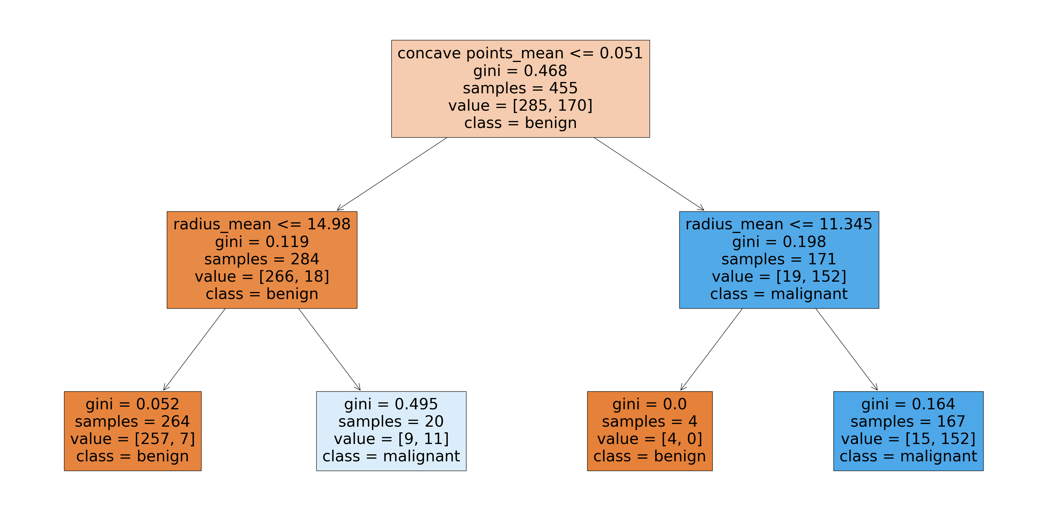
my humble ML course
Decision Regions
Region in feature space where all instances are assigned to one class label Decision regions are separated by surfaces called decision-boundaries (SVM)

Slide 9
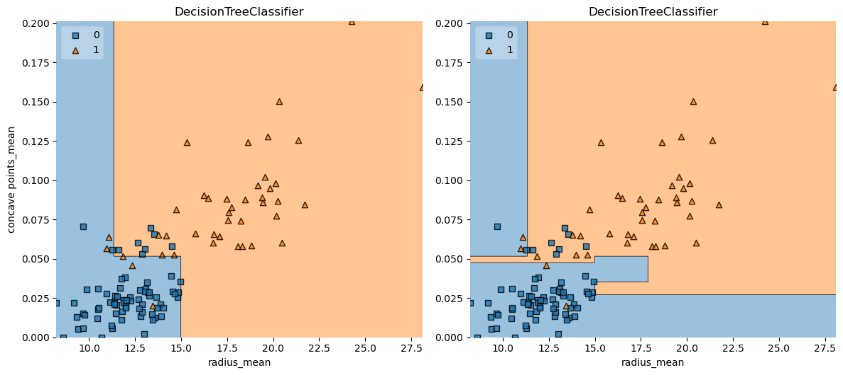
my humble ML course
Decision boundaries

Slide 10
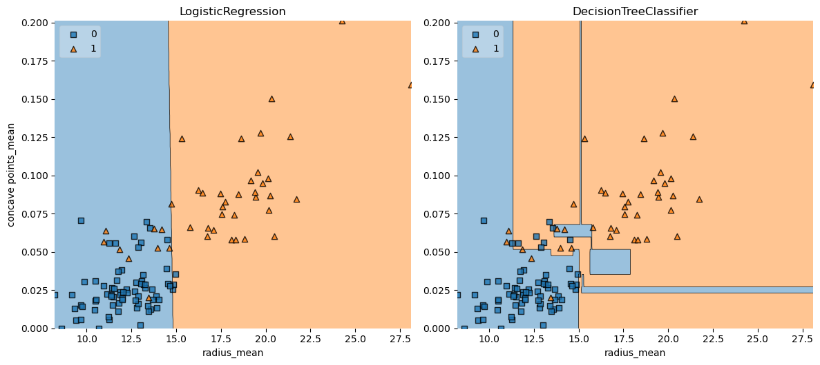
my humble ML course
Classifier (binary)

Slide 11
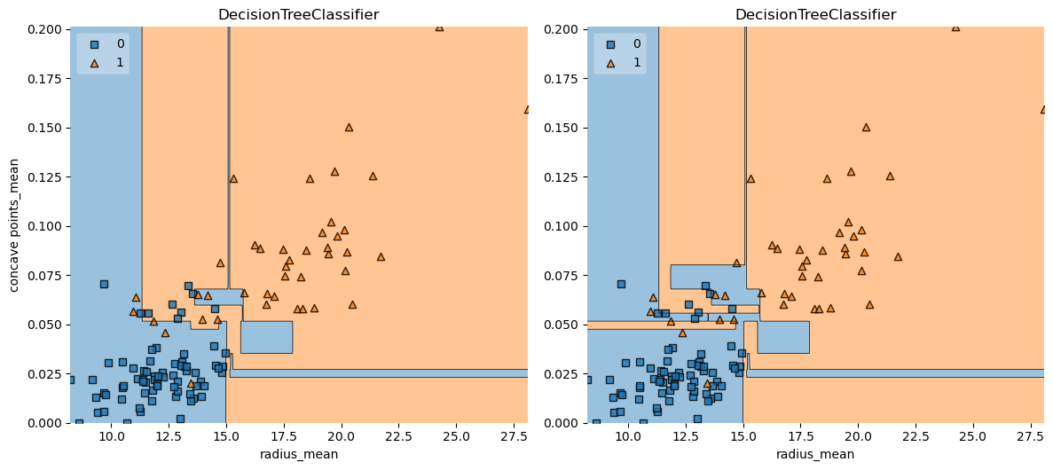
my humble ML course
Model
complexity
Notes:
DT
depth = 6 vs 3

Slide 12
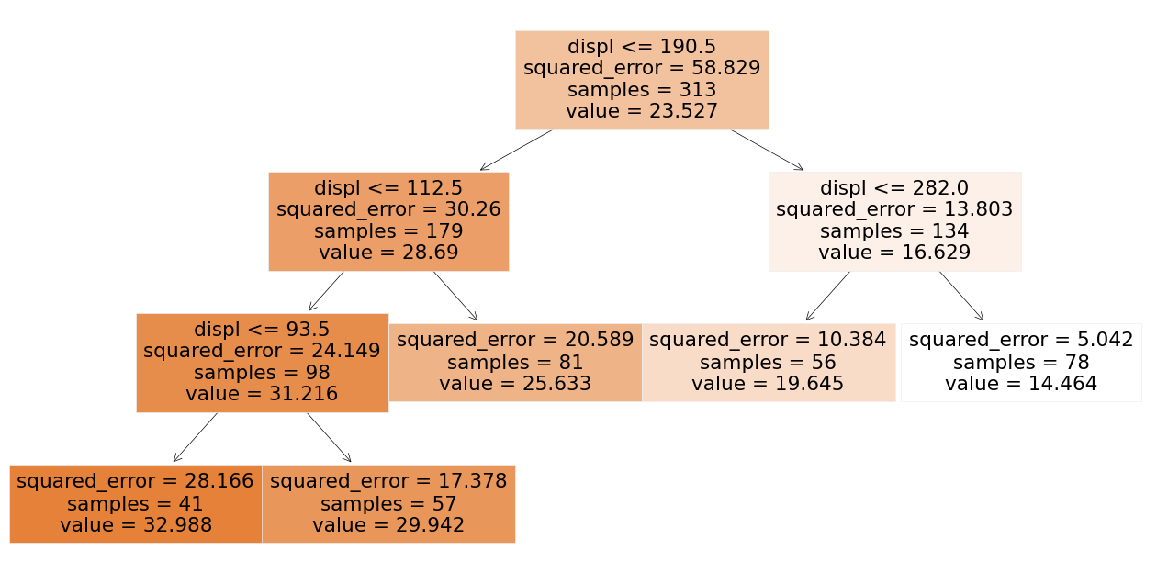
my humble ML course
Regressor

Slide 13
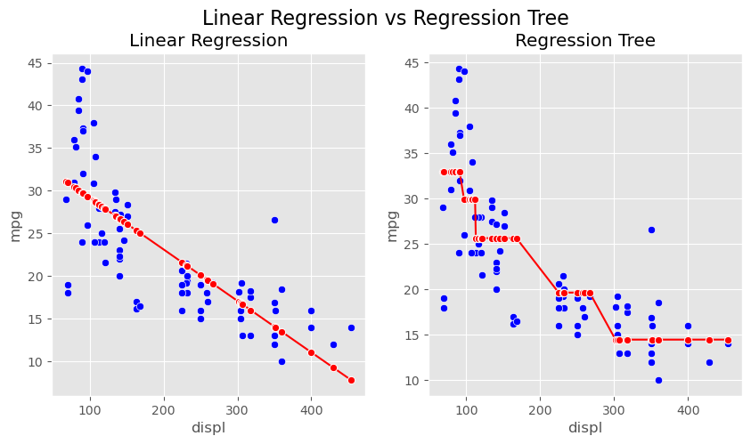
my humble ML course
Regressor

Slide 14

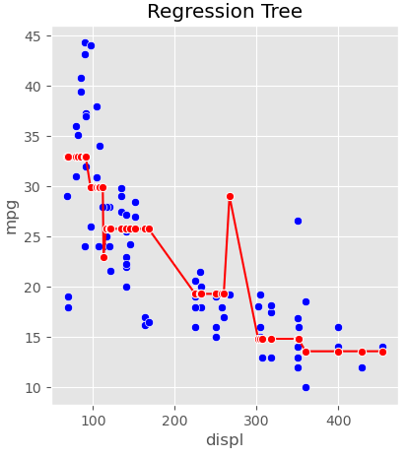
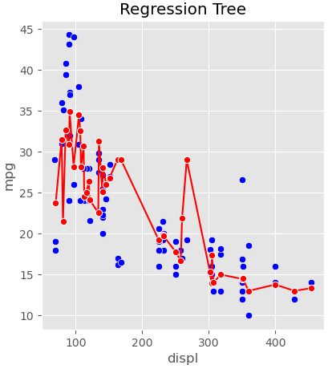
my humble ML course
Model complexity
Notes:
DT
depth = 6 vs 3

Slide 15

my humble ML course
Code

Slide 16
my humble ML course
Bibliography
https://github.com/kamperh/data414
https://polakowo.io/datadocs/docs/machine-learning/tree-based-models
https://towardsdatascience.com/why-random-forests-outperform-decision-trees-1b0f175a0b5
https://www.statistics.cool/post/why-do-random-forests-work/
https://luisvalesilva.com/datasimple/random_forests.html
Notes:
https://miro.com/app/board/uXjVMZythnw=/

Slide 17
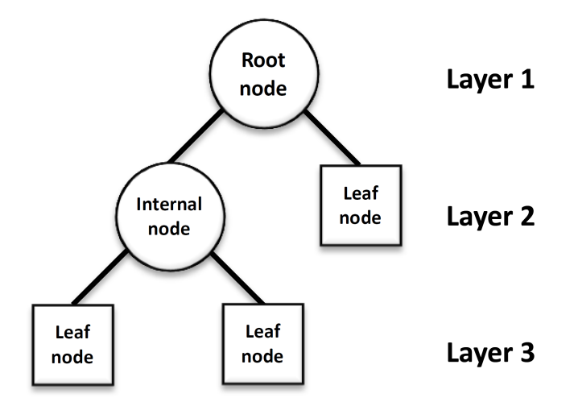
C4 – DT growing algorithm
my humble ML course

Slide 18
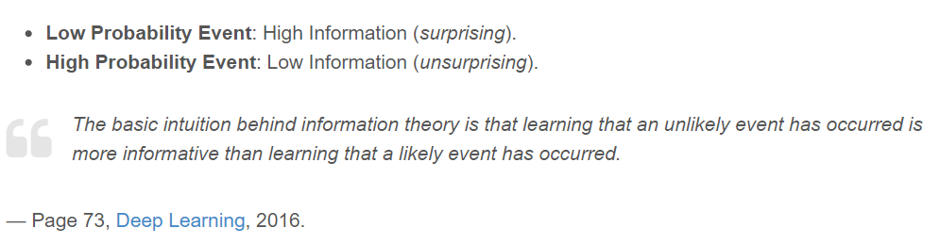
my humble ML course
Information
.

Slide 19
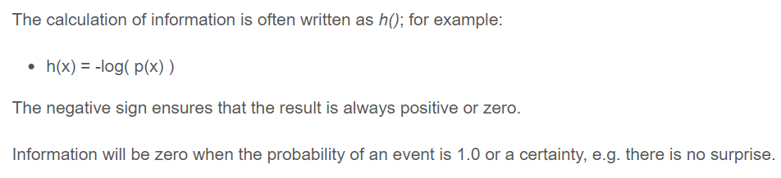
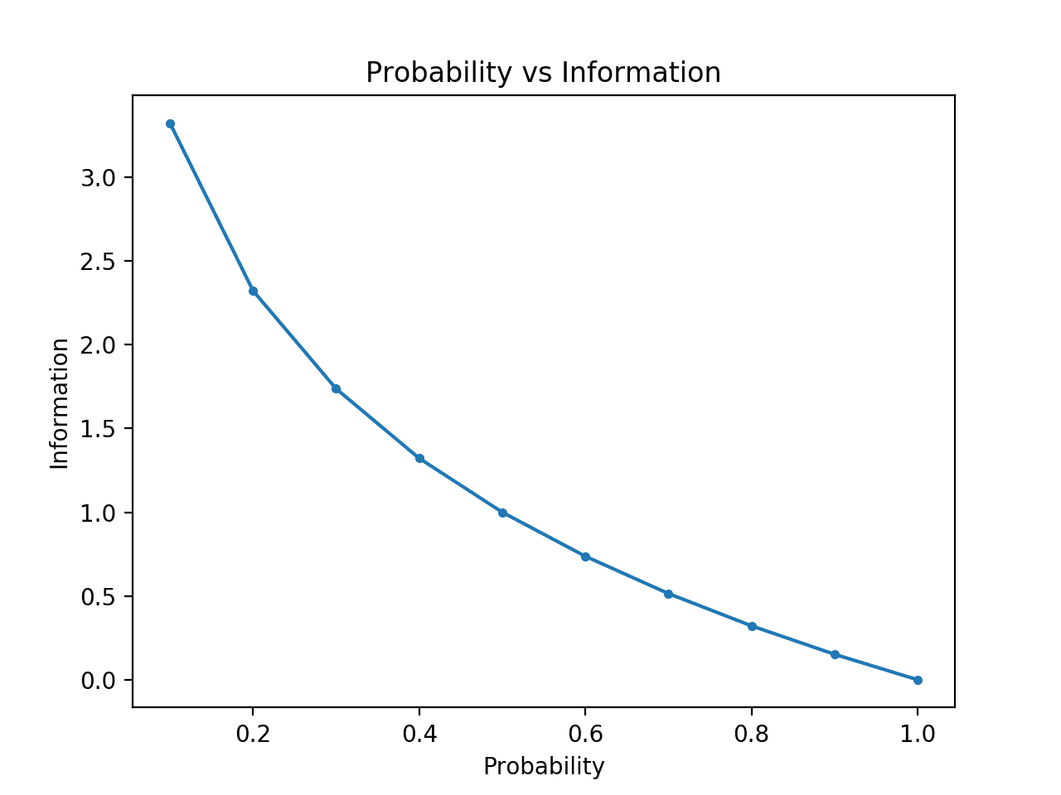
my humble ML course
Information
.

Slide 20
my humble ML course
Information Gain
TODO

Slide 21
my humble ML course
Entropy
TODO

Slide 22
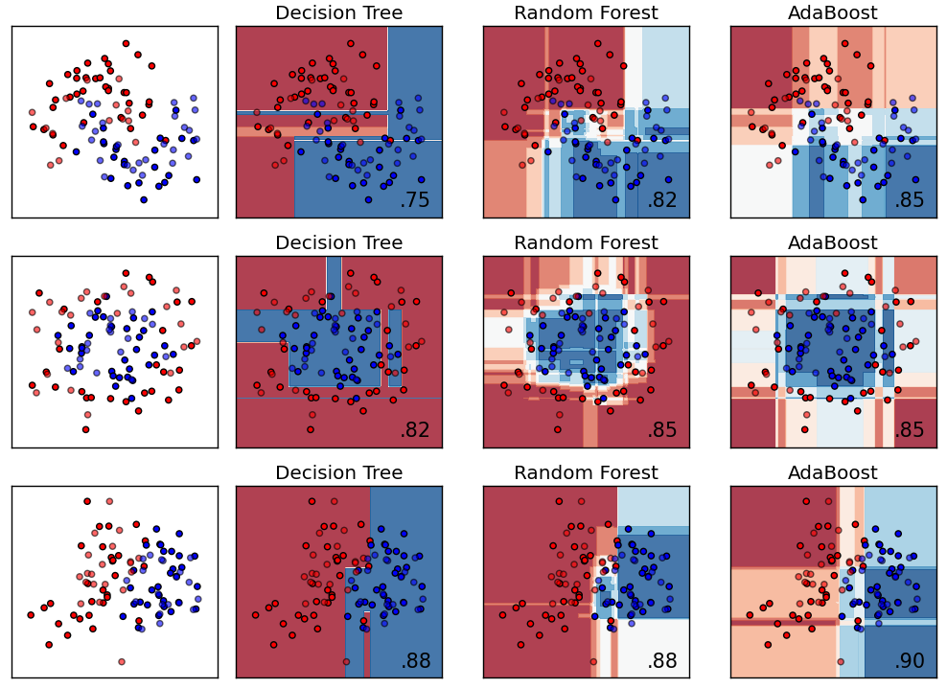
my humble ML course
more tree based models
TODO
Notes:
tree based models in Google

